Slide 1



Crop Disease Detection and Soil Analysis
Department : Information Technology
Group ID: 18
Group Members:
1. Shreeraj Rane (16010420086)
2. Surin Shah (16010420087)
3. Mayur Bhore (16010420090)
4. Shreyas Panchikattil (16010420096)
Group Mentor:
Prof. Chirag Desai

Slide 2



Problem Definition
This project aims to develop a computer vision-based website that can automate the identification of diseases in maize cultivation. The objective is to provide farmers with an efficient and accurate tool to protect their crops and minimize potential losses.
Additionally, the project proposes the use of machine learning algorithms to estimate agricultural output, which can assist farmers in selecting suitable crops based on soil type and weather conditions.
The website aims to provide a user-friendly portal that offers farmers a one-stop-shop for information about crop selection and soil type, facilitating informed decision-making.
Ultimately, the project aims to improve crop yield and increase profitability for farmers by providing them with advanced technology and data-driven insights.

Slide 3

Literature Survey
.
Sr. No | Title | Authors | Year | Abstract
1 | OPNN: Optimized Probabilistic Neural Network based Automatic Detection of Maize Plant Disease Detection | E. Akanksha, N. Sharma and K. Gulati. | 2021 | The proposed method uses an optimized probabilistic neural network (OPNN) to classify the maize plant images into healthy or diseased categories. The OPNN model is optimized using a particle swarm optimization (PSO) algorithm to improve its accuracy. Experimental results demonstrate that the proposed OPNN model achieves high accuracy in detecting maize plant diseases, outperforming traditional machine learning algorithms.
2 | Plant diseases detection using image processing techniques | S. K. Tichkule and D. H. Gawali | 2016 | This project provides a survey of various methods used for plant leaf disease detection using image processing techniques. The k-nearest-neighbor method is simple but slow, while neural networks are tolerant to noise but have complex structures. Support vector machines (SVM) were found to be competitive with other machine learning algorithms for classifying high-dimensional data sets.

Slide 4
Literature Survey
.
Sr. No | Title | Authors | Year | Abstract
3 | Identification of Maize Leaf Diseases Using Improved Deep Convolutional Neural Networks | X. Zhang, Y. Qiao, F. Meng, C. Fan and M. Zhang. | 2018 | This research paper proposes an improved CNN model to identify maize leaf diseases. The model consists of convolutional and pooling layers, fully connected layers, and a soft-max classifier. To enhance performance, techniques like data augmentation, dropout regularization, and transfer learning were applied. Experimental results show that the proposed model achieved an accuracy of 96.5%, outperforming several deep learning and traditional machine learning models.
4 | Soil Analysis Using Visible and Near Infrared Spectroscopy | Wetterlind, Johanna & Stenberg, Bo & Viscarra Rossel, Raphael. | 2013 | Soil nutrient content, including nitrogen, phosphorus, and potassium were estimated using near-infrared (NIR) spectroscopy and machine learning algorithms. The authors achieved good prediction accuracy using partial least squares regression (PLSR) and random forest algorithms.

Slide 5
Literature Survey
.
Sr. No | Title | Authors | Year | Abstract
5 | Soil analysis and crop fertility prediction using machine learning | Jagdeep Yadav, Shalu Chopra, Vijayalakshmi M | 2021 | A model for predicting soil fertility, crop prediction, and crop yield based on soil and crop datasets from the Indian region using machine learning algorithms. The model was tested using different algorithms and found that the Artificial Neural Network (ANN) had the highest accuracy in all three predictions. .
6 | Soil moisture prediction using machine learning | S. Prakash, A. Sharma and S. S. Sahu | 2018 | This paper presents a study on the use of machine learning methods to predict soil moisture in advance. The study utilized multiple linear regression, support vector regression, and recurrent neural network models for the prediction. The results showed that multiple linear regression outperformed support vector regression and recurrent neural network.

Slide 6





Scope (Functional Requirements)
Disease Detection and Diagnosis
Customized Treatment Options
Smarter Crop Selection
The website should be able to analyze images of crops and accurately identify the presence of diseases.
The website should be able to provide information on the type of disease identified and recommend appropriate treatment options.
The website should provide farmers with information on crop selection based on soil type and weather conditions.
Predictive Yield Analysis
User-Friendly Design
The website should be able to estimate agricultural output based on various factors such as weather, soil type, and crop characteristics.
The website should provide a user-friendly interface for farmers to access and interact with the different features and functionalities.

Slide 7





Scope (Non-Functional Requirements)
Security and Privacy
Scalability and Performance
Cross-Platform Compatibility
The website should be secure and protect the privacy of users.
The website should be able to handle a large volume of data and user requests without experiencing downtime or performance issues.
The website should be accessible from different devices and platforms.
Speed and Responsiveness
Easy Maintenance
The website should be fast and responsive to ensure a seamless user experience.
The website should be easy to maintain and update, with minimal downtime required for maintenance activities.

Slide 8
Data Set Description
The Maize and Corn Disease dataset, available on Kaggle, contains images of healthy maize and corn plants, as well as plants infected with four different diseases: Gray Leaf Spot, Common Rust, Northern Leaf Blight, and Healthy. The dataset consists of a total of 4,000 images, with 1,000 images for each class. The images were collected from different regions in Uganda, Africa. The dataset can be used for developing and testing machine learning models for the detection and classification of maize and corn diseases.
Link: https://www.kaggle.com/datasets/smaranjitghose/corn-or-maize-leaf-disease-dataset
The dataset is about precision agriculture and aims to help farmers make informed decisions about the most suitable crops to grow in a particular farm based on various parameters. The dataset includes parameters such as N, P, and K, which are ratios of Nitrogen, Phosphorous, and Potassium content in the soil, as well as temperature, humidity, pH value of the soil, and rainfall in millimeters. The data was built by augmenting datasets of rainfall, climate, and fertilizer data available for India.
Link: https://www.kaggle.com/datasets/atharvaingle/crop-recommendation-dataset

Slide 9





Technology used
1. Front-end Development: React.
2. Back-end Development: Flask.
3. Model Development: Gradient boosting trees, EfficientNetB2.

Slide 10
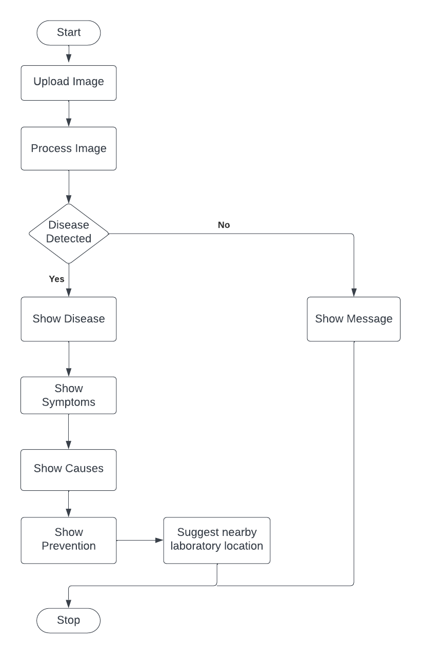
Maize Disease Detection System Flowchart

Slide 11
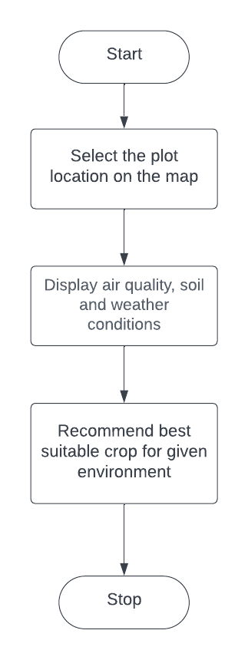
Soil Analysis Flowchart

Slide 12
REFERENCES
[1] E. Akanksha, N. Sharma and K. Gulati, "OPNN: Optimized Probabilistic Neural Network based Automatic Detection of Maize Plant Disease Detection," 2021 6th International Conference on Inventive Computation Technologies (ICICT), Coimbatore, India, 2021, pp. 1322-1328, doi: 10.1109/ICICT50816.2021.9358763.
[2] S. K. Tichkule and D. H. Gawali, "Plant diseases detection using image processing techniques," 2016 Online International Conference on Green Engineering and Technologies (IC-GET), Coimbatore, India, 2016, pp. 1-6, doi: 10.1109/GET.2016.7916653.
[3] X. Zhang, Y. Qiao, F. Meng, C. Fan and M. Zhang, "Identification of Maize Leaf Diseases Using Improved Deep Convolutional Neural Networks," in IEEE Access, vol. 6, pp. 30370-30377, 2018, doi: 10.1109/ACCESS.2018.2844405.
[4] Wetterlind, Johanna & Stenberg, Bo & Viscarra Rossel, Raphael. (2013). Soil Analysis Using Visible and Near Infrared Spectroscopy. Methods in molecular biology (Clifton, N.J.). 953. 95-107. 10.1007/978-1-62703-152-3_6.
[5] Yadav, Jagdeep, Shalu Chopra, and M. Vijayalakshmi. "Soil analysis and crop fertility prediction using machine learning." Machine Learning 8.03 (2021).
[6] S. Prakash, A. Sharma and S. S. Sahu, "Soil Moisture Prediction Using Machine Learning," 2018 Second International Conference on Inventive Communication and Computational Technologies (ICICCT), Coimbatore, India, 2018, pp. 1-6, doi: 10.1109/ICICCT.2018.8473260.

Slide 13




Timeline
18th March - 30th March
Frontend and Model Development for disease detection feature
16th April - 23rd April
Backend Development and Testing
10th Feb - 7th March
Data gathering and Preprocessing
1st April - 15th April
Frontend and Model Development for Crop Recommendation feature

Slide 14
Thank You!!!

